Slide 1
LSS Morphology Results

Slide 2
30-04-2019 Catch Up
Comments?

Slide 3
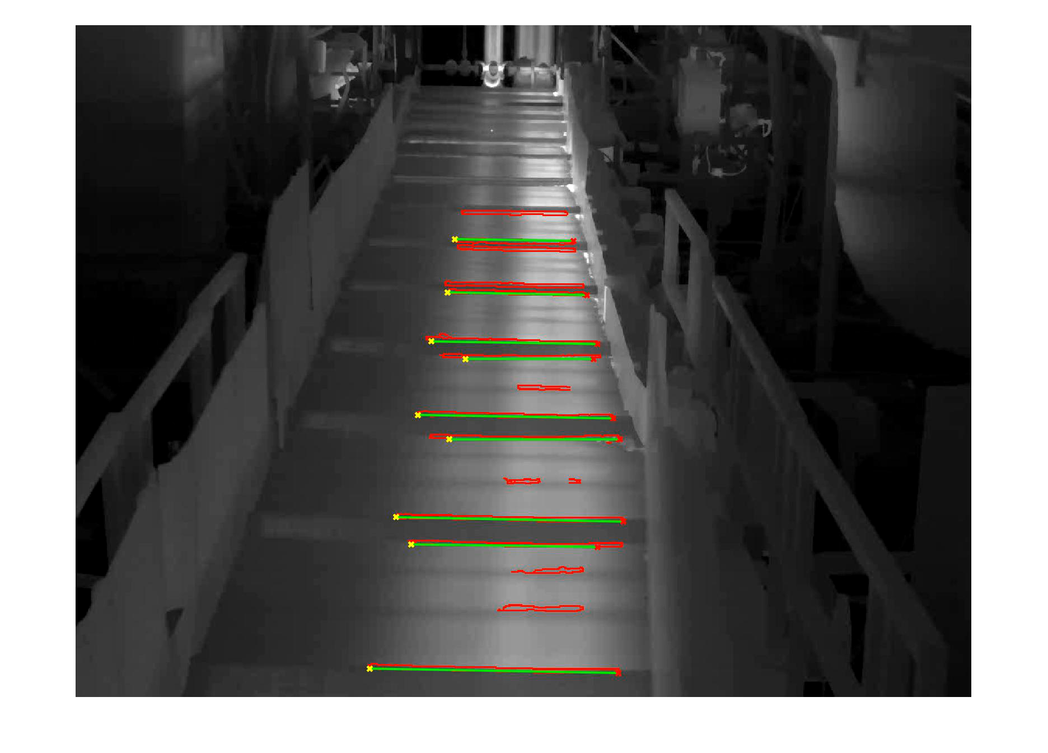
A demo video

Slide 4
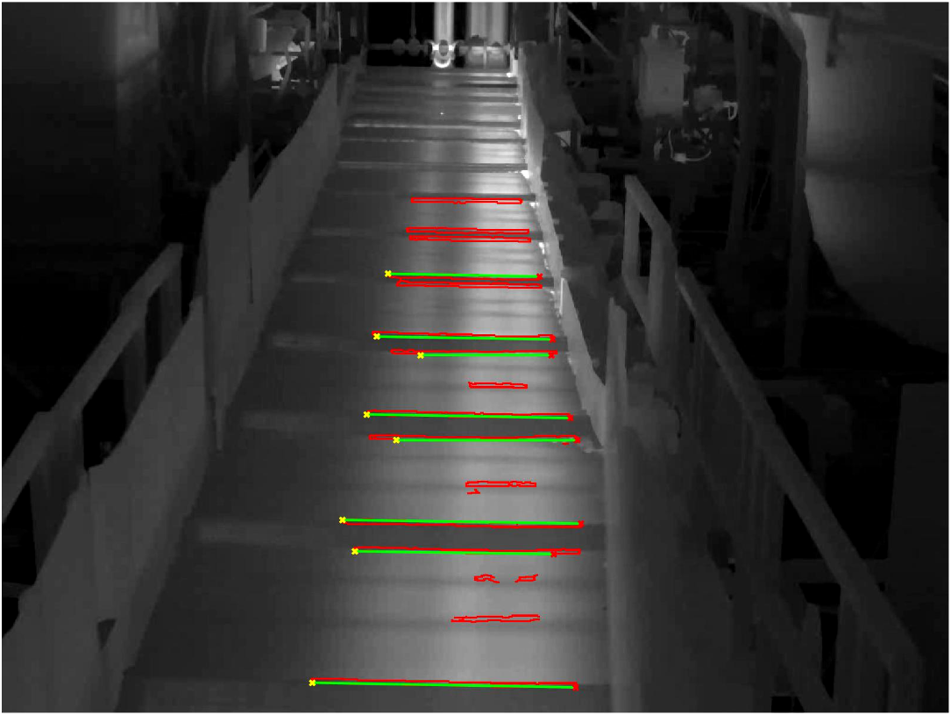
They are of the same physical length 1.85m

Slide 5
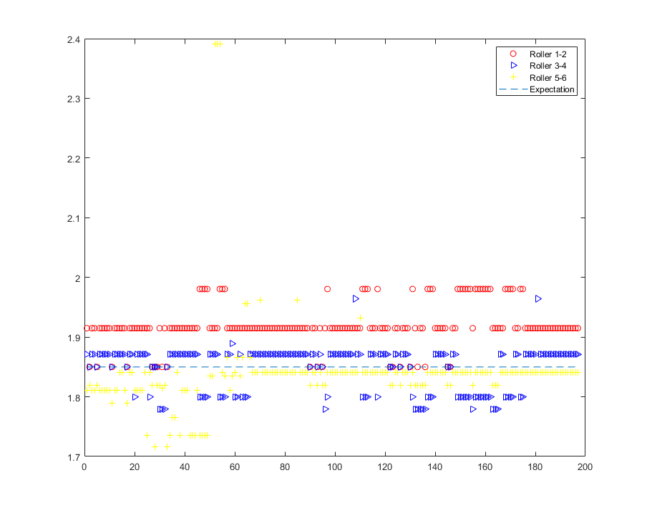
Set_1 x = 1.0028658382047198 y = 0.010852799221328105
X is the scaling factor
Y is the physical distance that the pixel in the middle of the first line corresponds to
Line 36 and lines 198-207 deleted
Due to 0
avg = ones(1,197) * 1.85
RMSE = sqrt(sum((Dist(:,3)-avg').^2)/197);
PE = Percentage Error
Root Mean Square Errors
 | Roller 1-2 | Roller 3-4 | Roller 5-6
RMSE(m) | 0.0779 | 0.0359 | 0.0777
PE | 4.2% | 1.9% | 4.2%

Slide 6
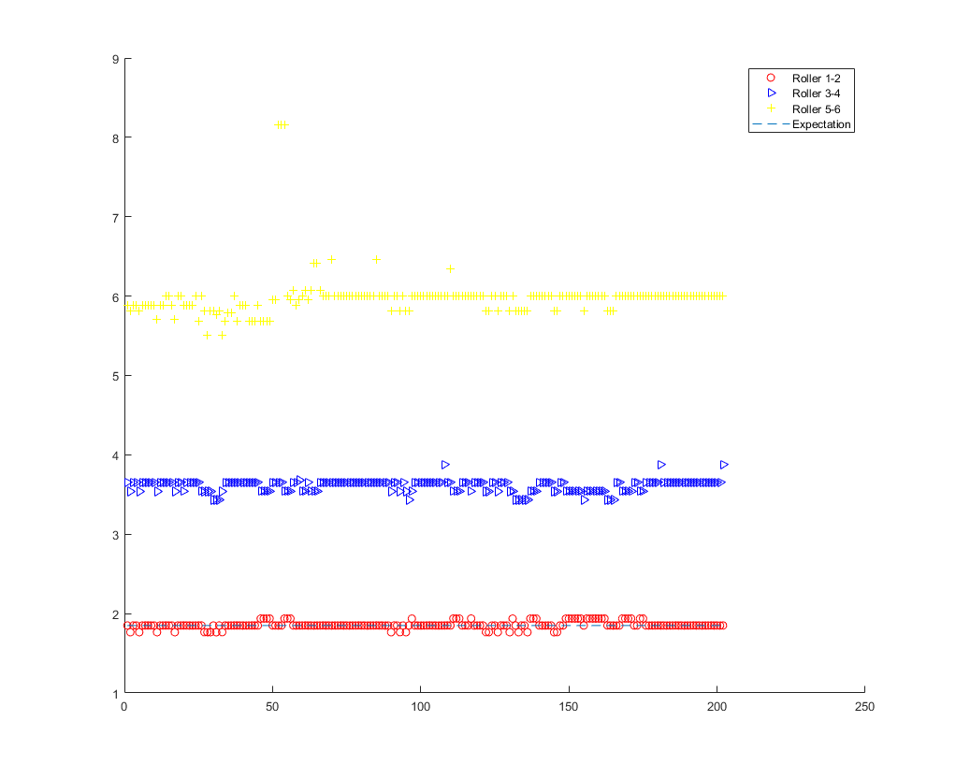
Set_2 x = 1.007835394289457 y = 0.007060949659788
X is the scaling factor
Y is the physical distance that the pixel in the middle of the first line corresponds to
Line 36 and lines 199-202 deleted
Due to 0
Totally 202 data used
avg = ones(1,202) * 1.85
RMSE = sqrt(sum((Dist(:,3)-avg').^2)/202);
PE = Percentage Error
Root Mean Square Errors
 | Roller 1-2 | Roller 3-4 | Roller 5-6
RMSE(m) | 0.0450 | 1.7609 | 4.1417
PE | 2.4% | 95.2% | 223.9%

Slide 7
The END for today
Thank you

Slide 8
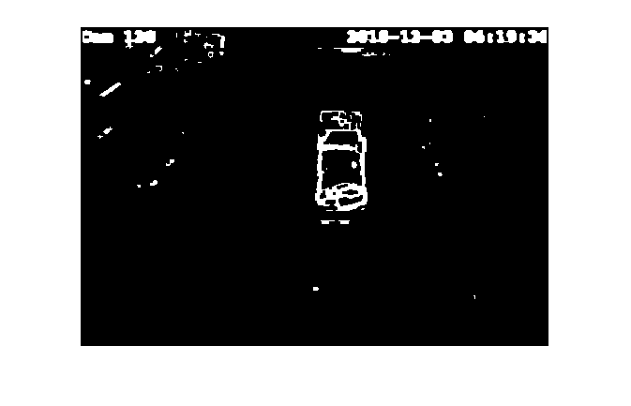
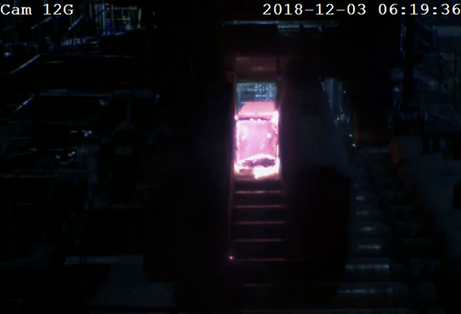
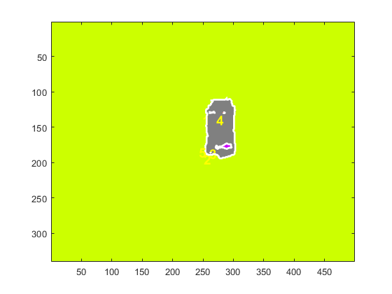
Cam 12G: 2018-12-03 06:19:36
Morphological Method
Original Image
2D boundary tracking

Slide 9
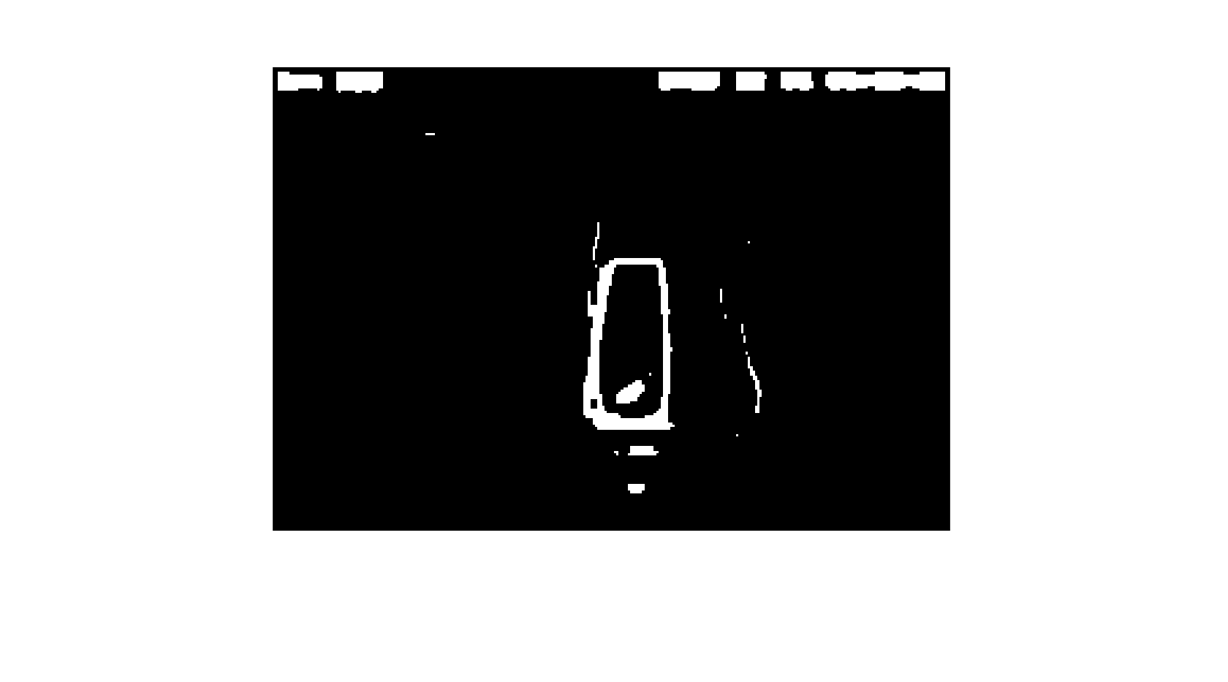
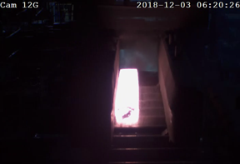
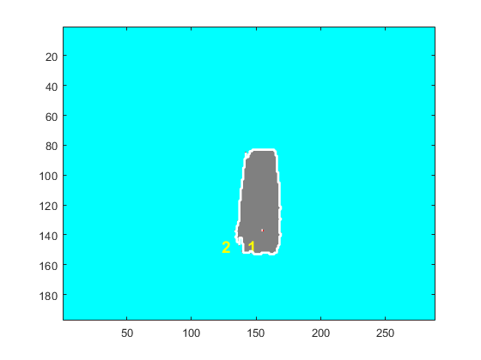
Cam 12G: 2018-12-03 06:20:26
Morphological Method
Original Image
2D boundary tracking

Slide 10
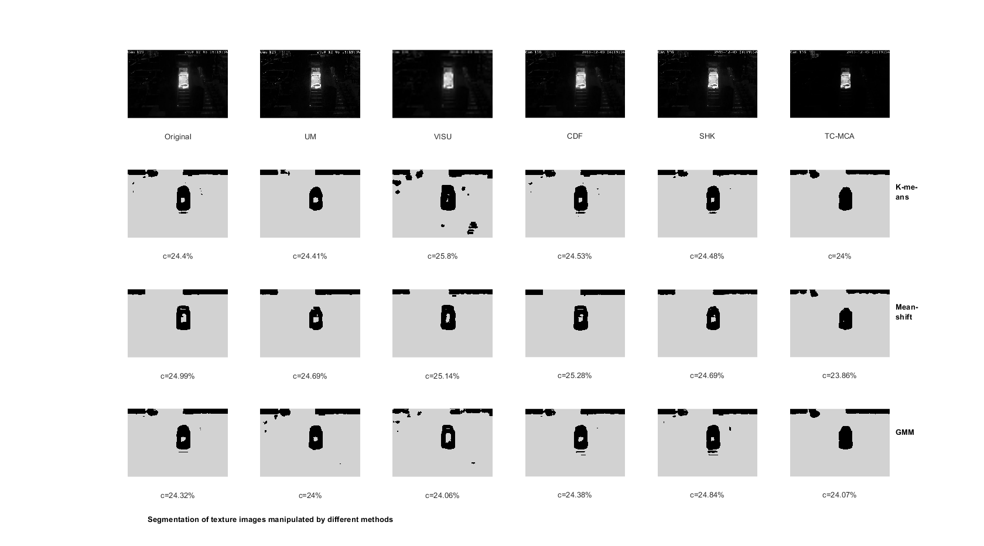
Texture enhance method
Cam 12G: 2018-12-03 06:19:36

Slide 11
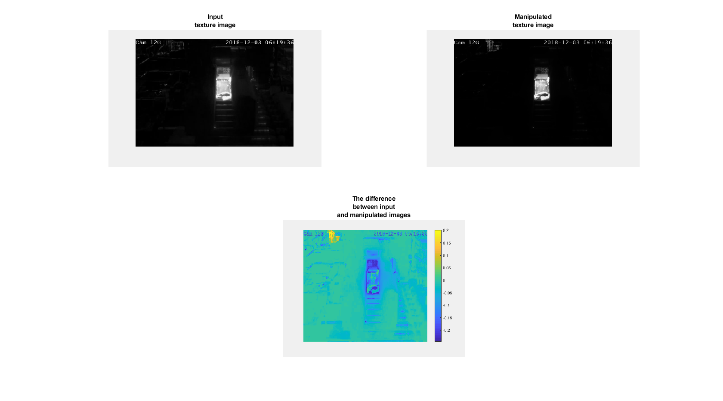

Slide 12
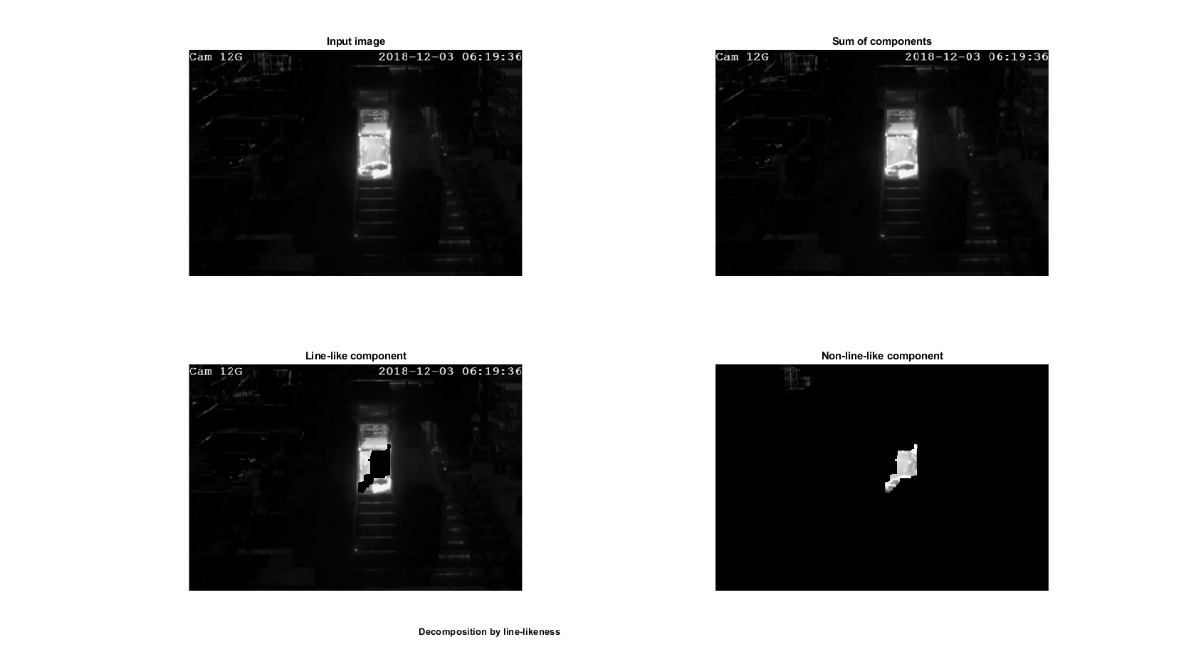

Slide 13
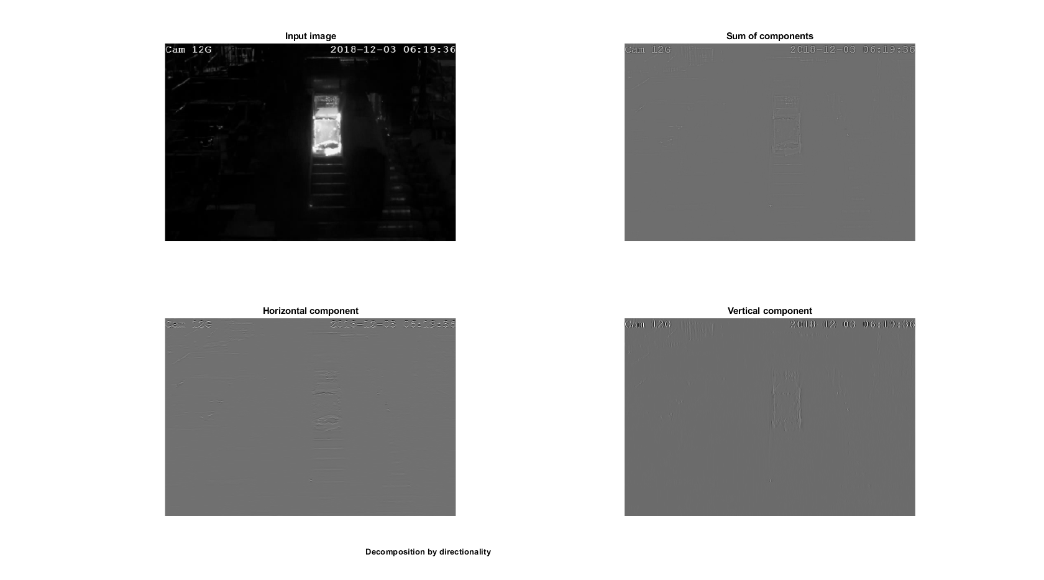

Slide 14
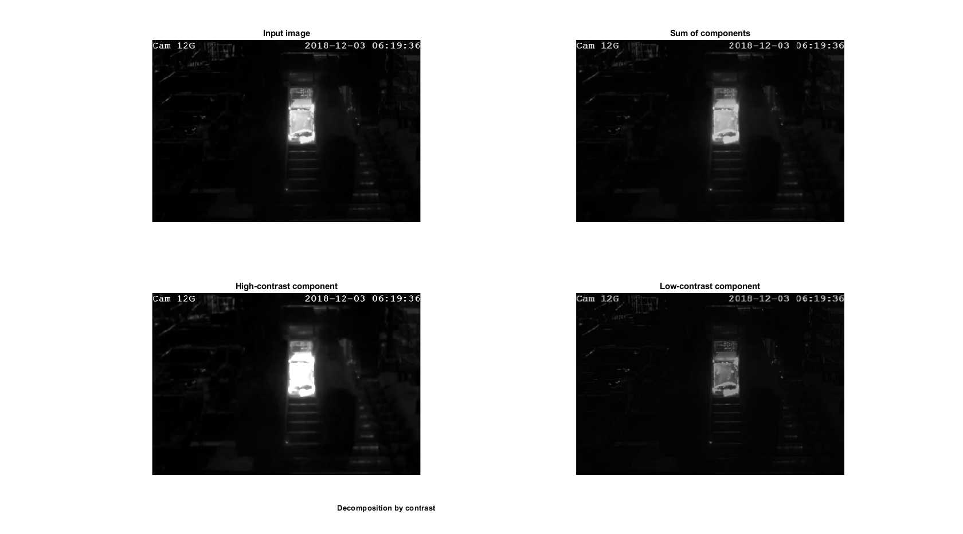

Slide 15
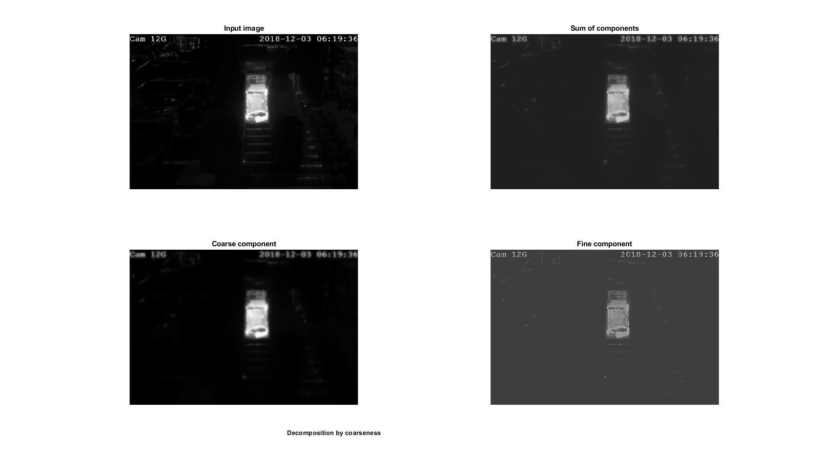

Slide 16
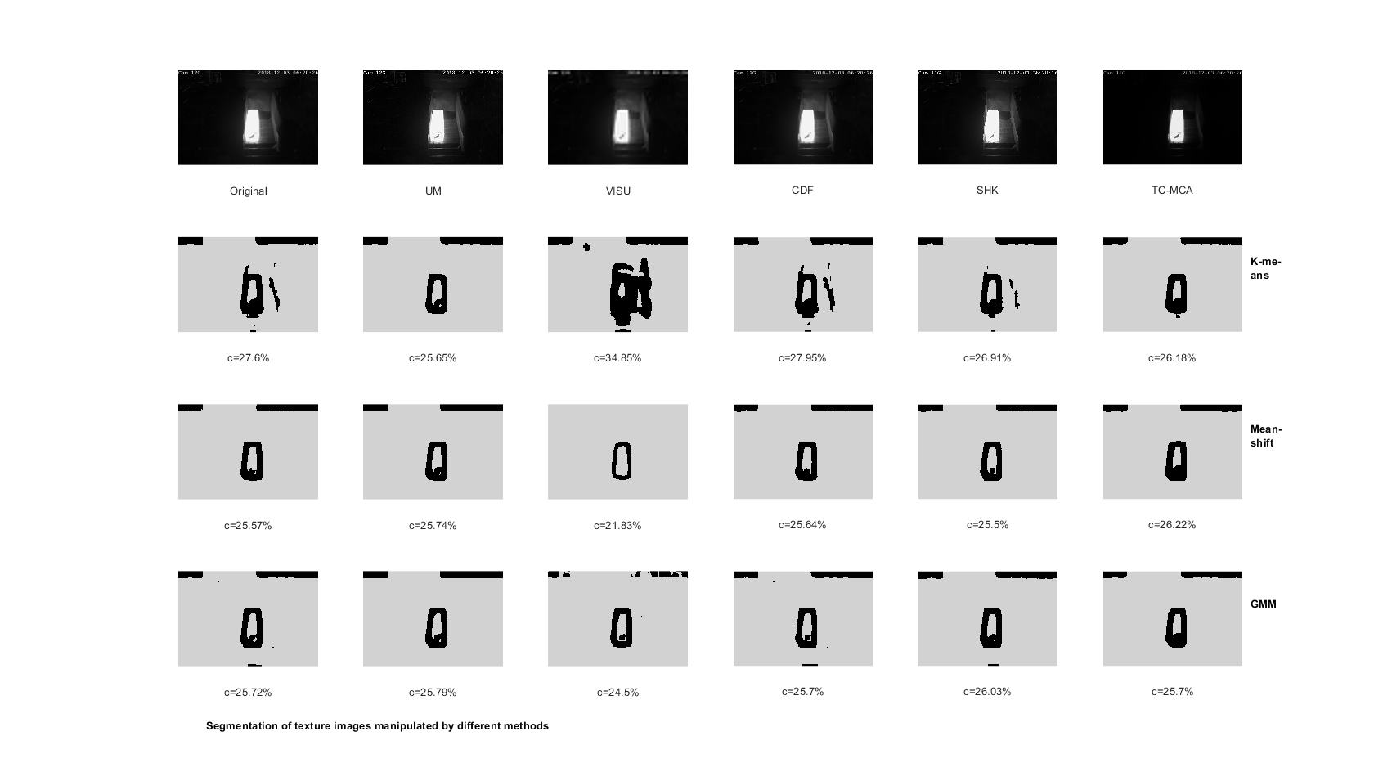
Texture enhance method
Cam 12G: 2018-12-03 06:20:26

Slide 17
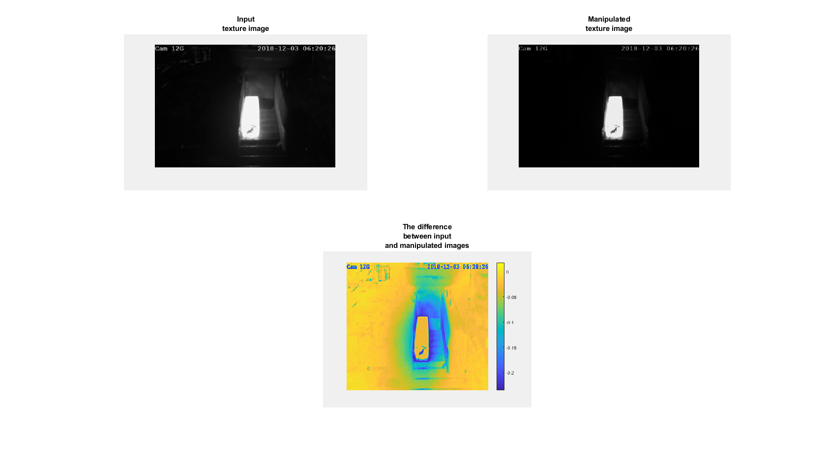
Cam 12G: 2018-12-03 06:20:26

Slide 18
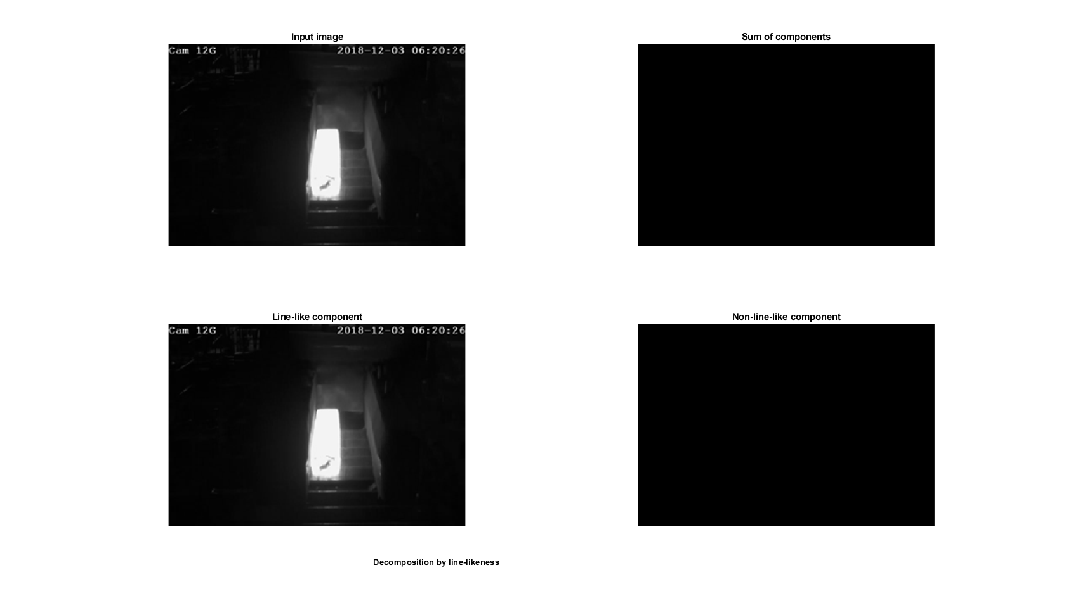
Cam 12G: 2018-12-03 06:20:26

Slide 19
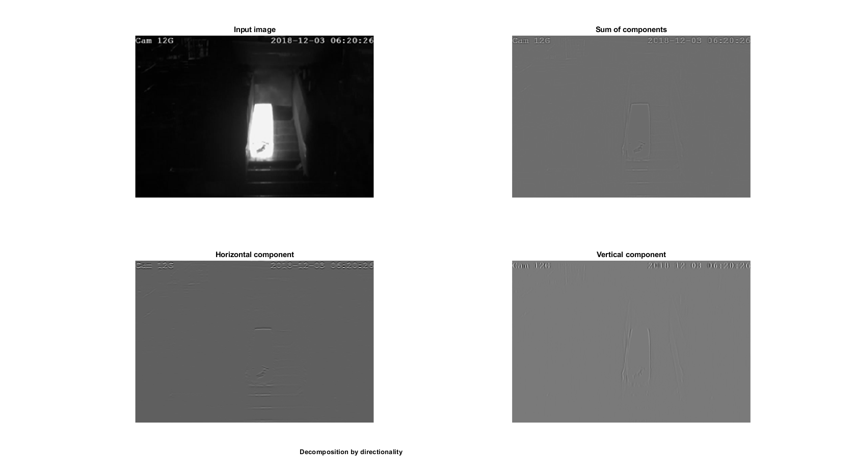

Slide 20
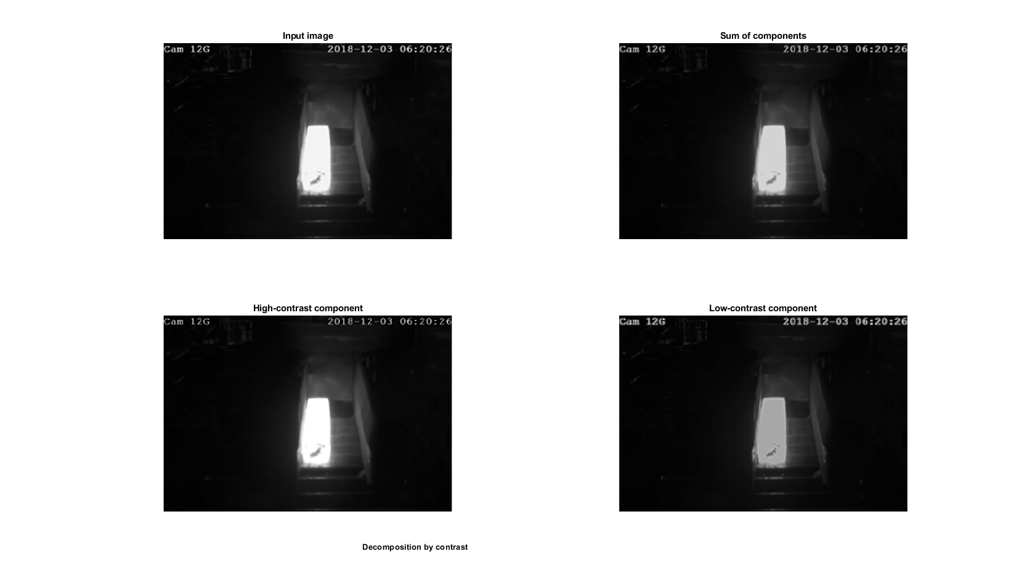

Slide 21
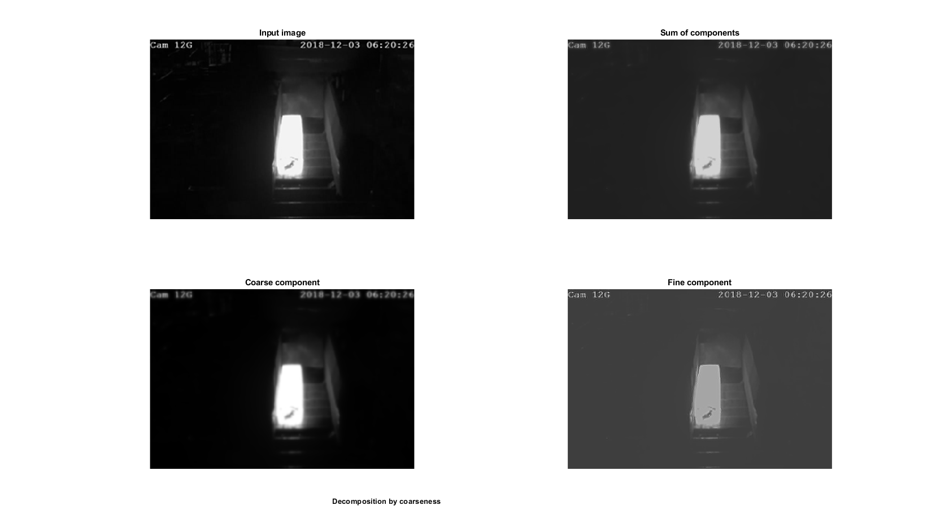

Slide 22
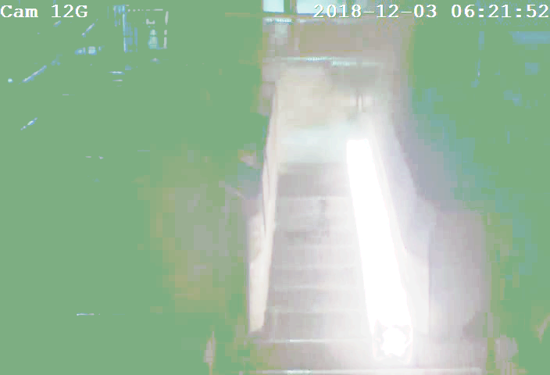
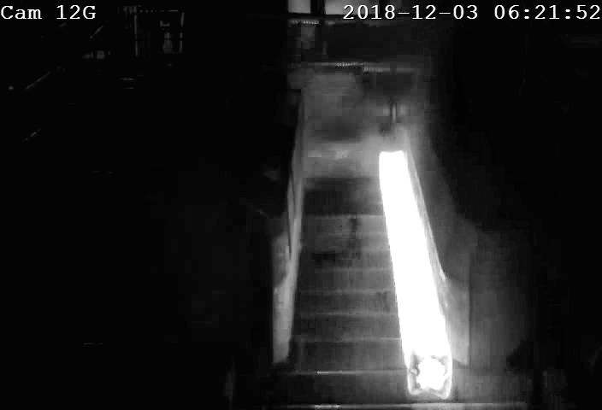
Histogram Equalization

Slide 23

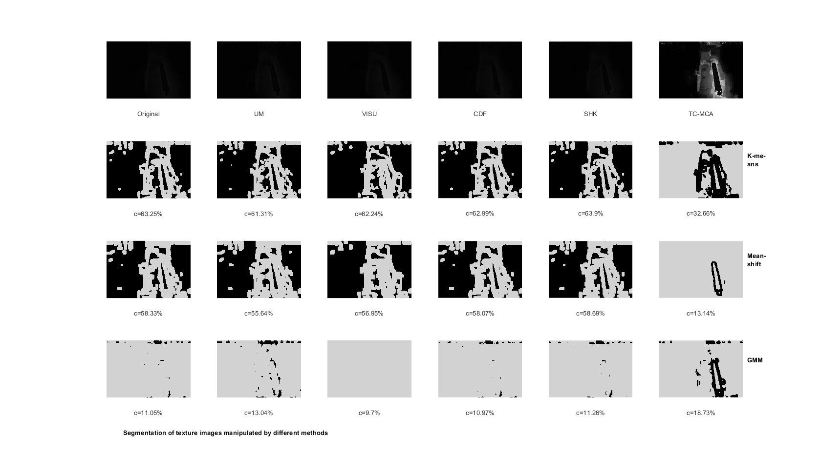

Slide 24
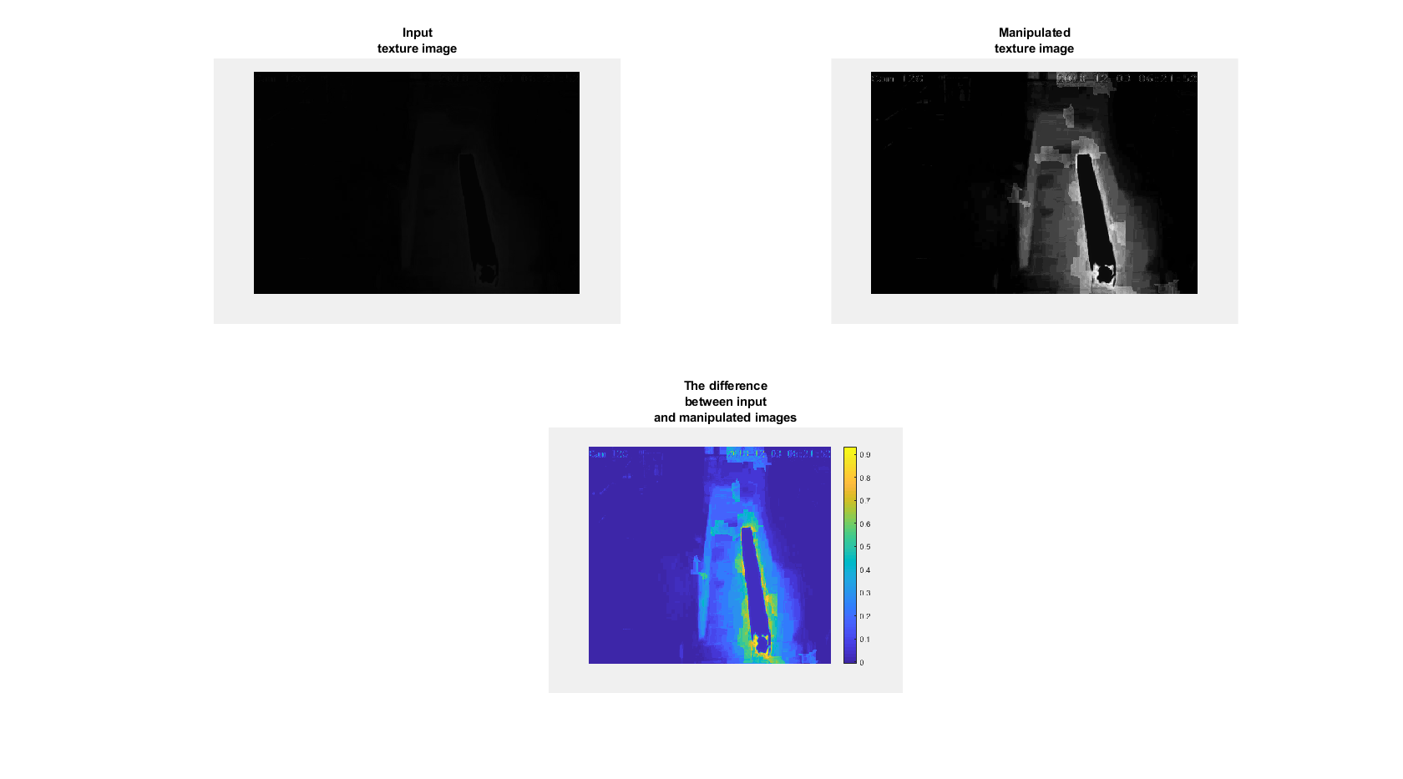

Slide 25
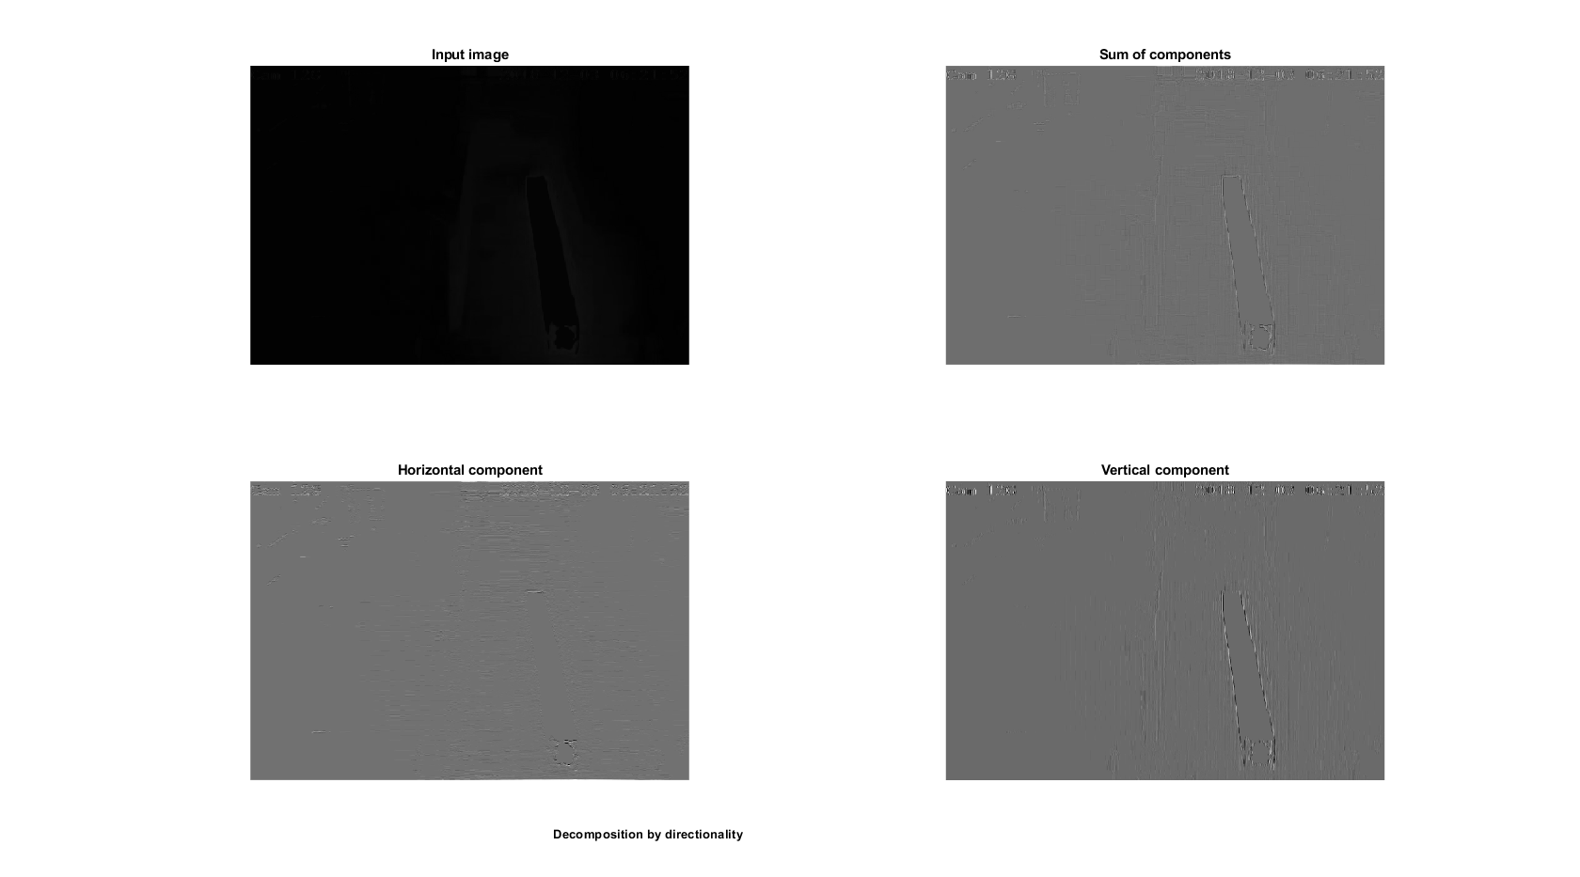

Slide 26
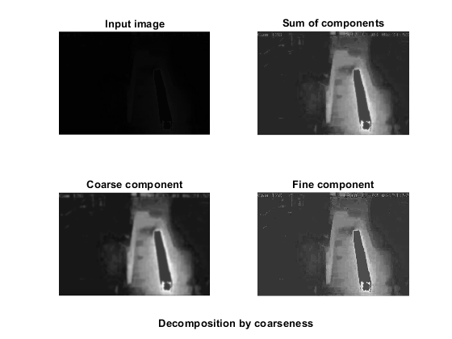

Slide 27
Catch-up 29/01/2019
Thermal/IR data collection
1.1 Hiring from a company
Thermal Vision Research Ltd;
15 Robert Robinson Ave, Oxford OX4 4GP
Contact: Matthew Clavey
Tel: 0333 200 4667 – Mobile: 07973 403819
1.2 Install colour gel to the webcam
2. In parallel, proceed with the current video data (Results are in the ‘Results’ Folder in the shared drive)
3. Camera parameters/more videos from Martin
4. Middle-term deliverables: Preliminary results: Codes + Reports
One mill data only
Rectangular steel sections
2D to 3D construction
Between May and June
5. Final deliverables: Final software +Reports
Extend to cylindrical sections
Improve and adjust the software

